Slide 1

HTML5, CSS3 & JavaScript
70-480
Microsoft Certification

Slide 2
Welcome
Auwais Khan
Technical Trainer
auwaisk@justit.co.uk

Slide 3
Exam Outline
Implement and manipulate document structures and objects (25-30%)
Implement Program Flow (20-25%)
Access and secure date (25-30%)
Use CSS3 in applications (25-30%)

Slide 4
Part 1 Learning Objectives
Learners would have a good understanding of:
Describe the new features of HTML5, and create and style HTML5 pages.
Add interactivity to an HTML5 page by using JavaScript.
Create HTML5 forms by using different input types, and validate user input by using HTML5 attributes and JavaScript code.
Send and receive data to and from a remote data source using XMLHTTPRequest objects and jQuery AJAX
Style HTML5 pages by using CSS3.
Create well-structured and easily-maintainable JavaScript code.

Slide 5

Part 2 Learning Objectives
Use common HTML5 APIs in interactive Web applications.
Create Web applications that support offline operations.
Create HTML5 Web pages that can adapt to different devices and form factors.
Add advanced graphics to an HTML5 page by using Canvas elements, and by using and Scalable Vector Graphics.
Enhance the user experience by adding animations to an HTML5 page.
Use Web Sockets to send and receive data between a Web application and a server.
Improve the responsiveness of a Web application that performs long-running operations by using Web Worker processes.

Slide 6



The Web Development Trifecta
HTML5 – structures and describes Web page content
CSS3 – provides the formatting and "look" of a Web page
JavaScript – adds interactive, dynamic capabilities to Web pages

Slide 7
Semantic Markup and Progressive Enhancement
Semantic HTML is the use of HTML markup to reinforce the semantics, or meaning, of the information in web pages and web applications rather than merely to define its presentation or look.
Progressive Enhancement is the practice of adding technology in layers to a website to ensure that if all fails, content can still be accessed.
Separation of concerns
HTML
CSS
JAVASCRIPT
CONTENT
PRESENTATION
BEHAVIOUR

Slide 8
What is HTML5?
Is a collection of standards including CSS3 and JavaScript are part of the new definition:
HTML5 is the newest version of HTML and replaces HTML4
Eliminates the need and use of plugins such as Flash and Silverlight
HTML5 is cross-platform application
Visit the W3C website for:
HTML5 History

Slide 9
HTML5 New Features
New elements and attributes
Support for CSS3
New form controls
Video and audio integration
Graphics using Canvas
SVG
Drag and drop
Web storage
Geolocation

Slide 10
HTML5 New Semantic Elements (block elements)
Section
Nav
Header
Article
Footer
Aside
Figure
Figcaption
Address
Video and Audio
Canvas
Summary and Details
w3schools HTML tags
Periodic HTML table

Slide 11
HTML5 New Semantic Elements (inline elements)
Mark
Meter
Progress
Output
Time
w3schools HTML tags
Periodic HTML table

Slide 12

The Case Study

Slide 13

HTML5 Strategy
<section>
<header>
<div>
<nav>
<ul>
<li>
<a>
<div>
<div>
<div>
<div>
<a>
<i>
<img>
<a>
<span>

Slide 14
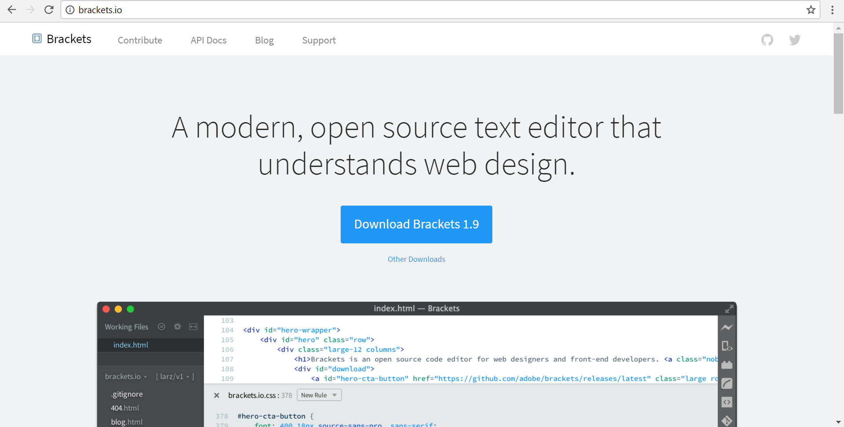
Text Editor

Slide 15
Canvas Introduction
Canvas creates a blank area on the screen via HTML using the <canvas> tag
JavaScript is then used to actually draw the content onto this space
Canvas has several methods that allow for the following –
drawing paths, boxes, circles, text, and adding images

Slide 16
Canvas in the exam
It will cover the following aspects –
How to initialise the Canvas on the HTML
Linking it via JavaScript
The correct order for the code
What certain lines of code do

Slide 17
Resources cont.
Relevant HTML5 websites for sample codes, examples and general information.
HTML5 w3schools
W3C
HTML5 MDN
Stack Overflow
Can I Use
Awwwards

Slide 18
Download Files
Access my GitHub account and download the
70-480 > day_1.
GitHub Account

Slide 19
Any Questions?
Let’s code

